Slide 1
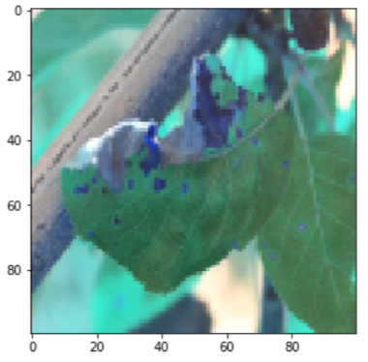
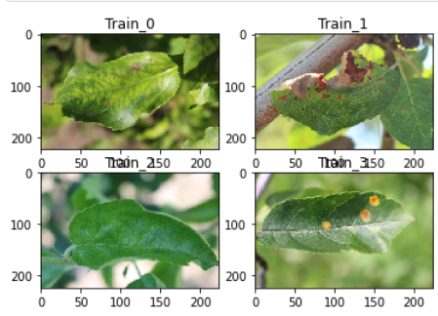
Plant pathology 2020 Computer Vision July 2021
מגישות:
קטיה בויקו - 336266028
גל אודנץ - 205892250

Slide 2
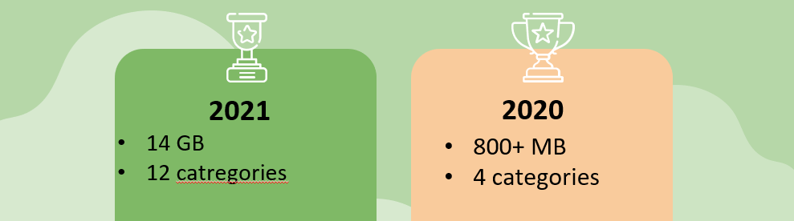
Project’s goals
classify a given image from testing dataset into different diseased category
distinguish between many diseases, sometimes more than one
Deal with rare classes and novel symptoms
search for relevant features

Slide 3
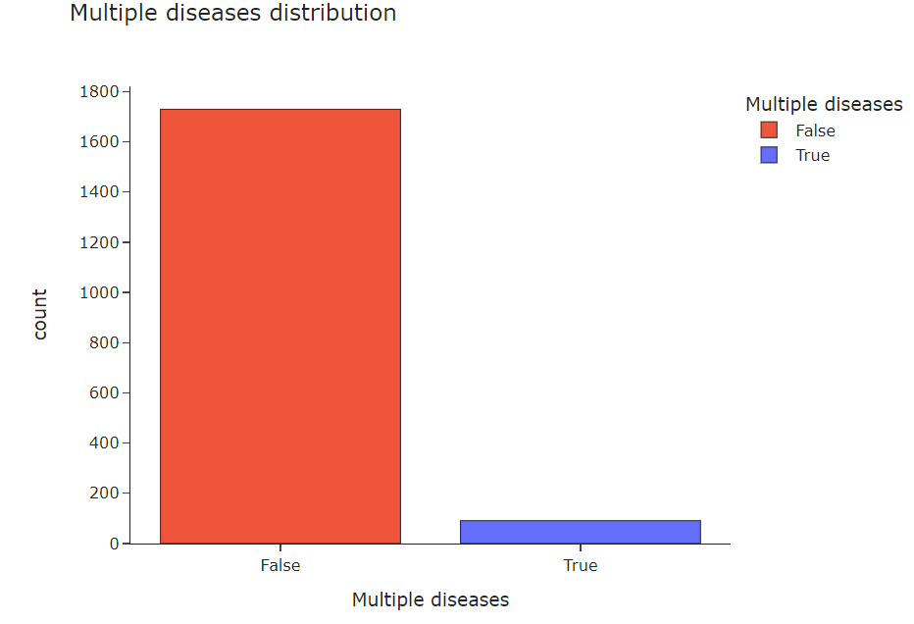
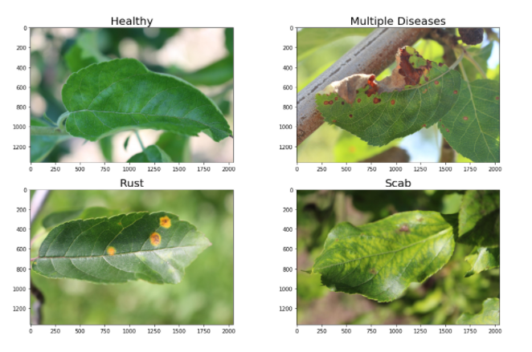
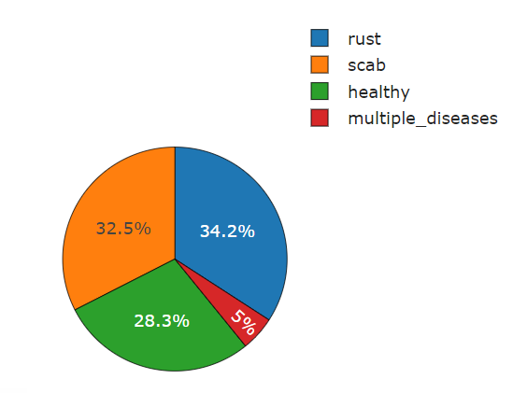
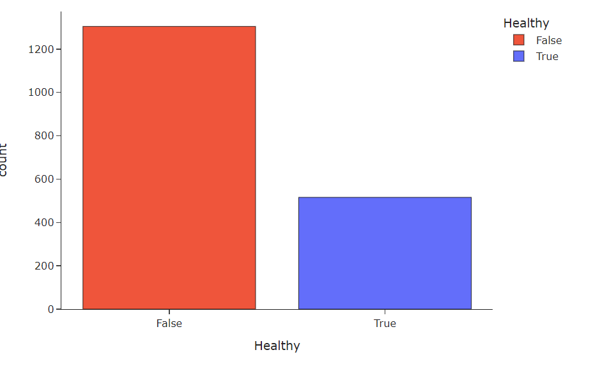
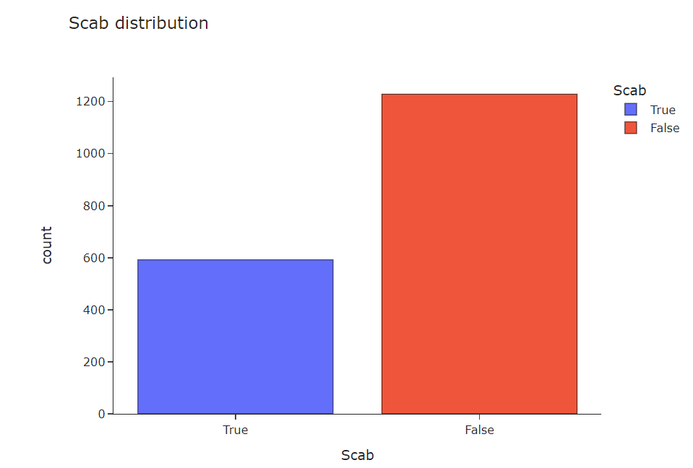
Exploring the dataset
Visualize each category
Label Distribution
Label Frequancy

Slide 4
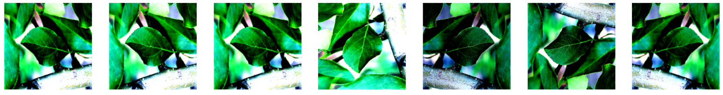
Augmentations
RandomBrightnessContrast
Horizontal & vertical Flip
RandomRotate90
Embossing’, sharpen, blur

Slide 5
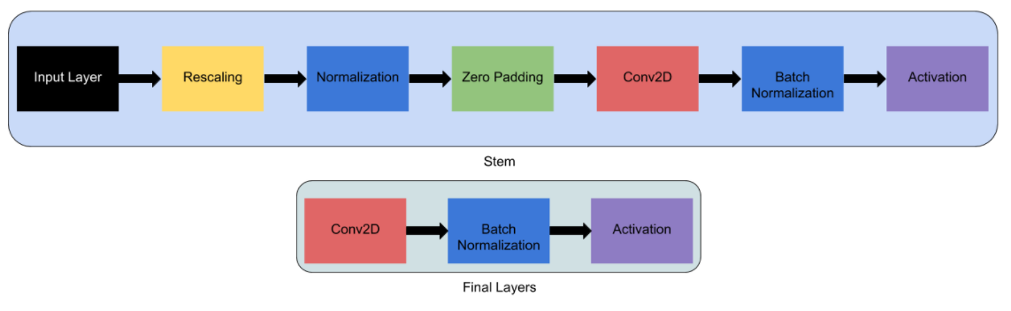
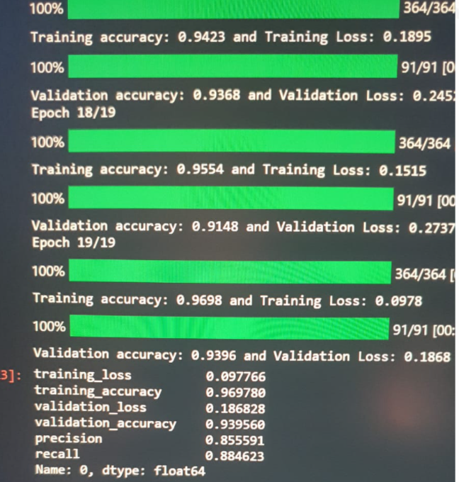
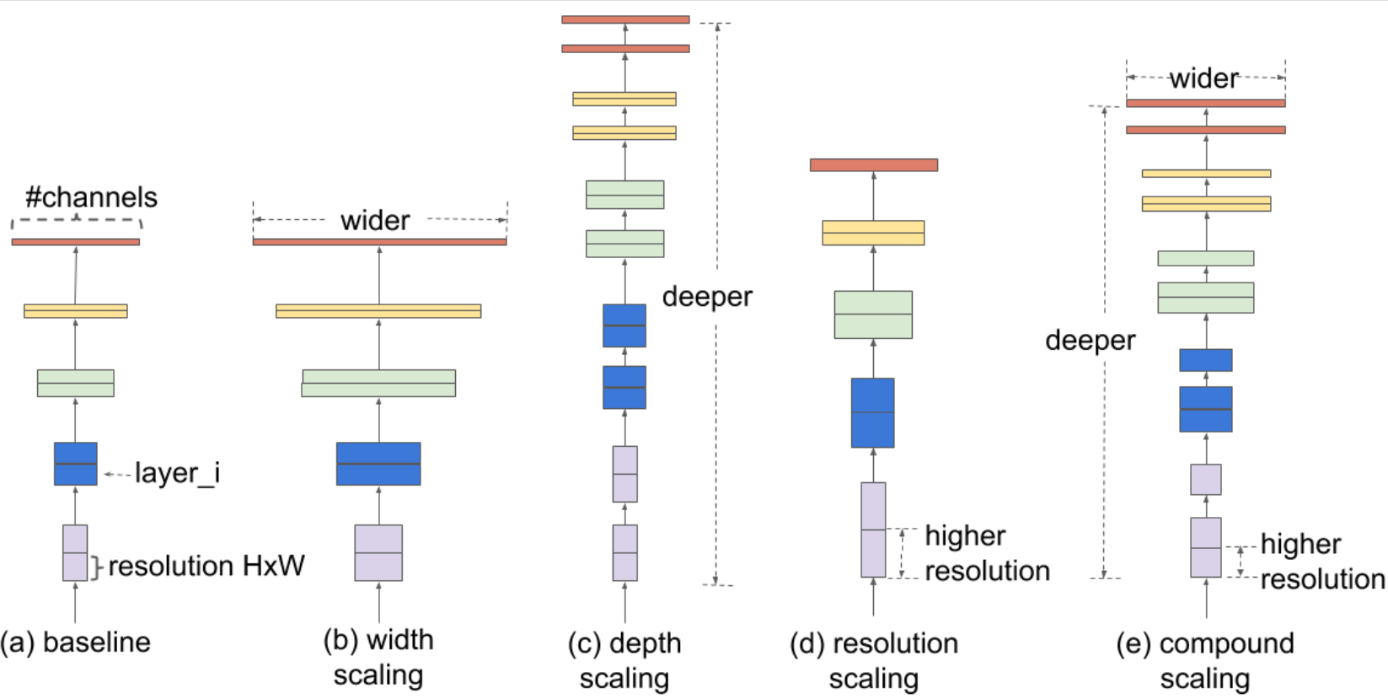
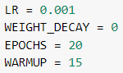
The models – efficientNet B7
Main principles: width (more features) , depth (more layers) , resolution (increasing resolution of the input image) – scaling with a constant ratio. It is smaller & faster than other CNNs.
We used get_cosine_schedule_with_warmup
First & Last layers of B6

Slide 6
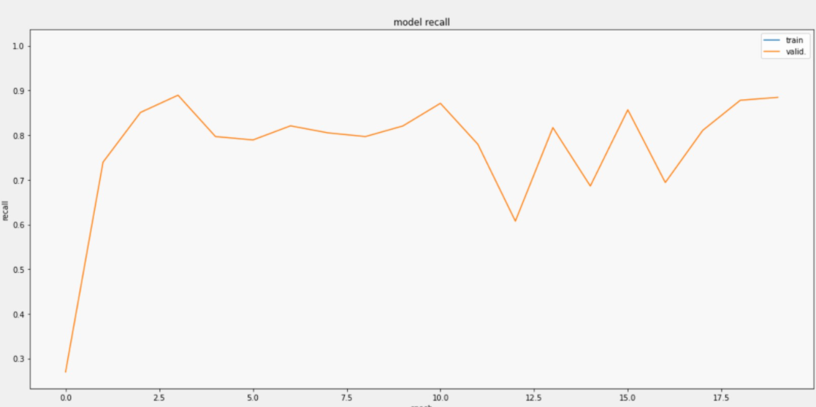
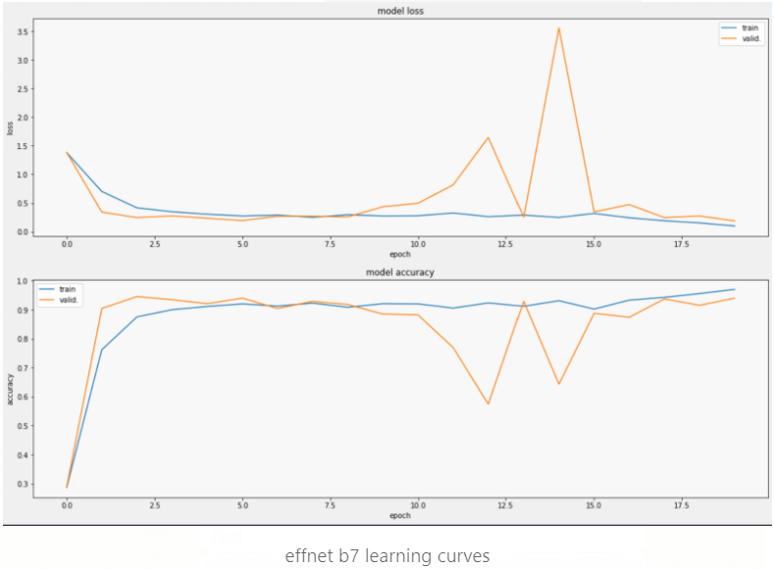
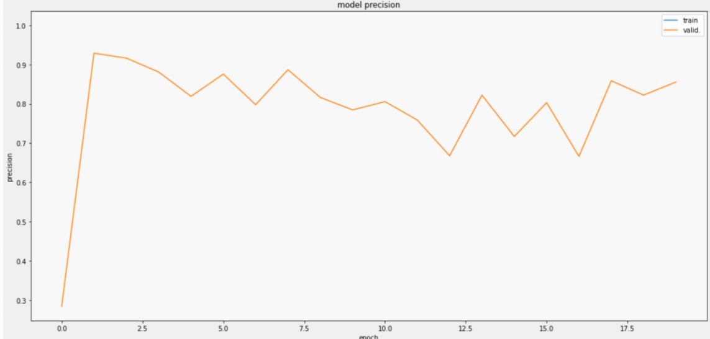
Learning curves
Model’s Results
Model recall
Model precision

Slide 7
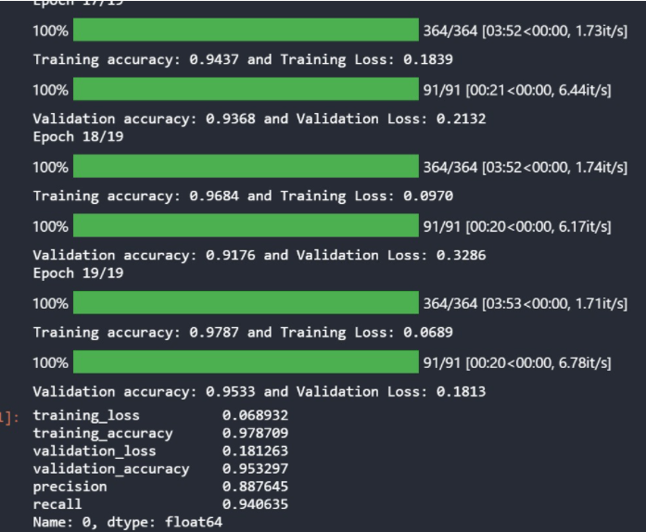
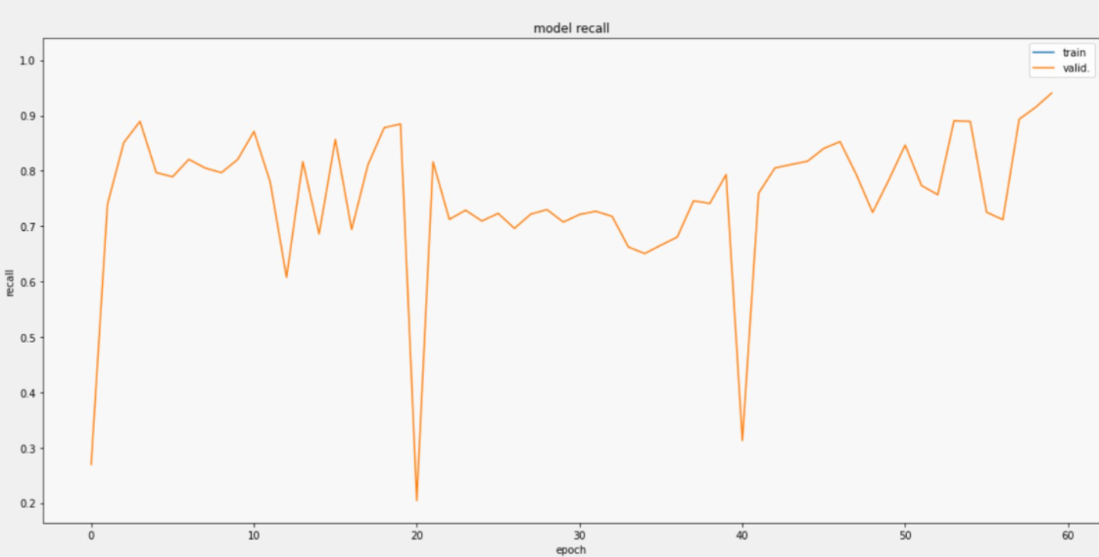
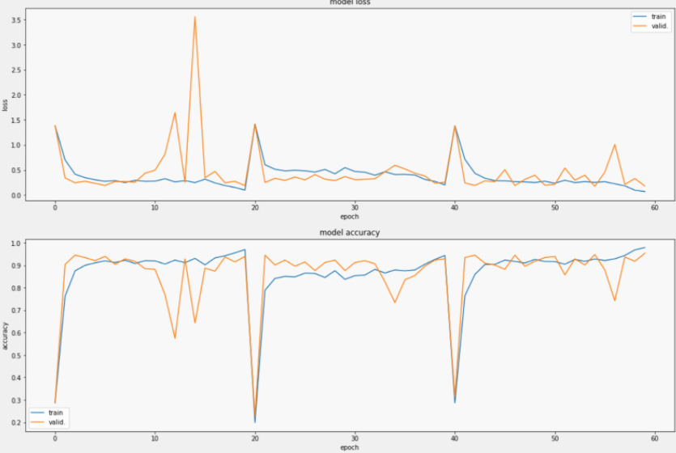
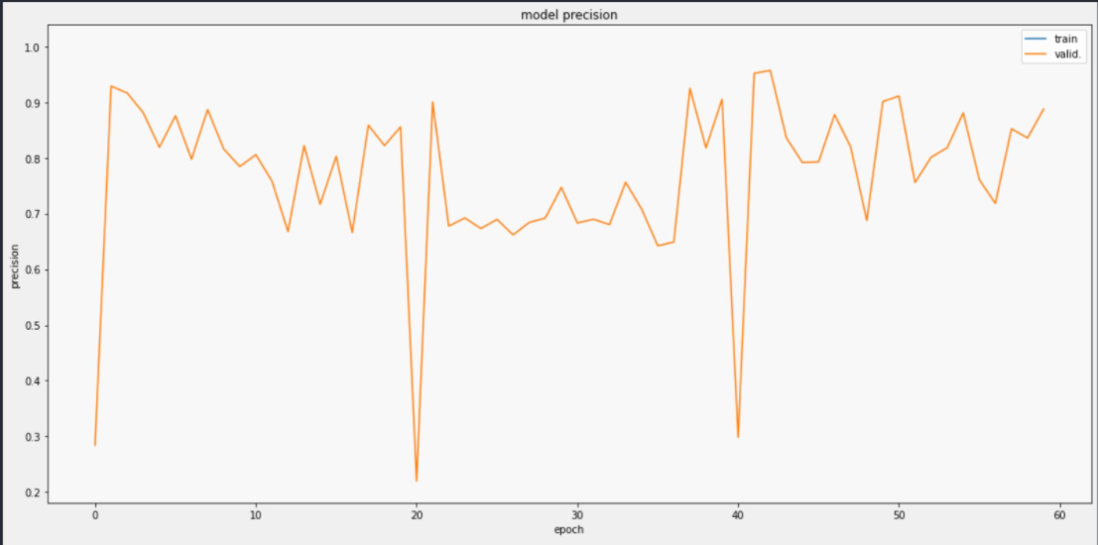
Learning curves
EfficientNet-B6 Results
Model recall
Model precision

Slide 8
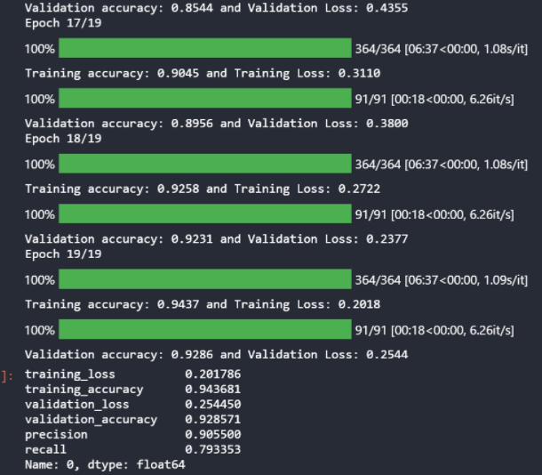
ResNext-101
We used
Results
Explanation
Next generation ResNets, more efficient and accurate, with 101 layers.
Timm models - resnext101_32x8d
Adam optimizer
cosine_schedule with warmup

Slide 9
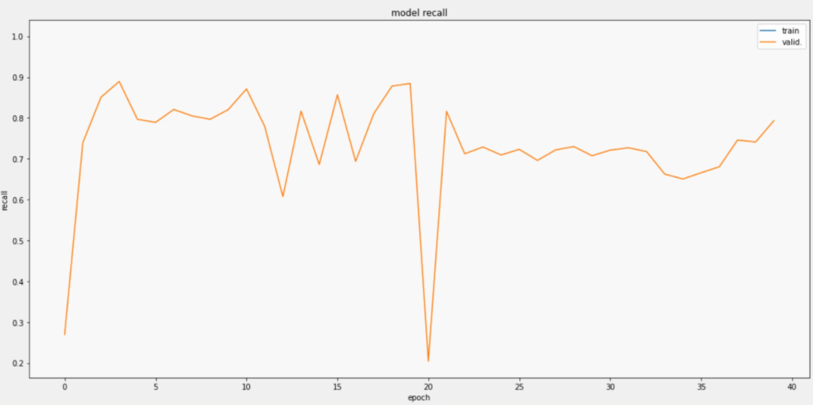
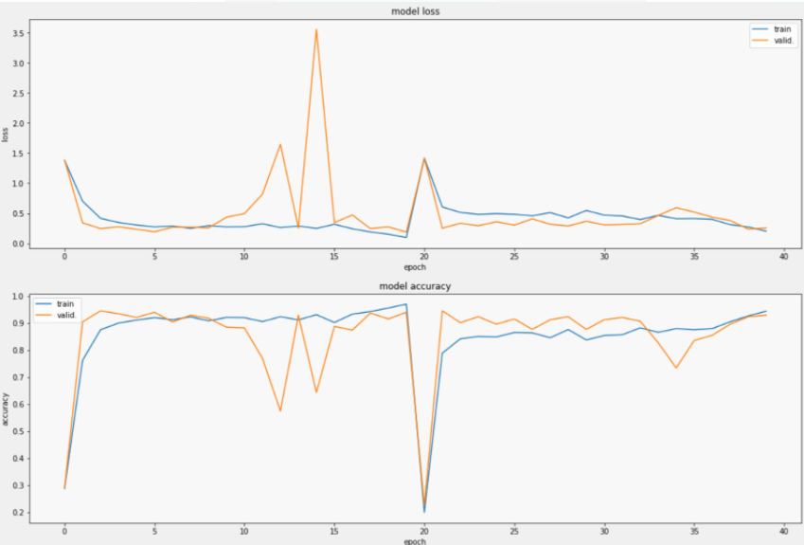
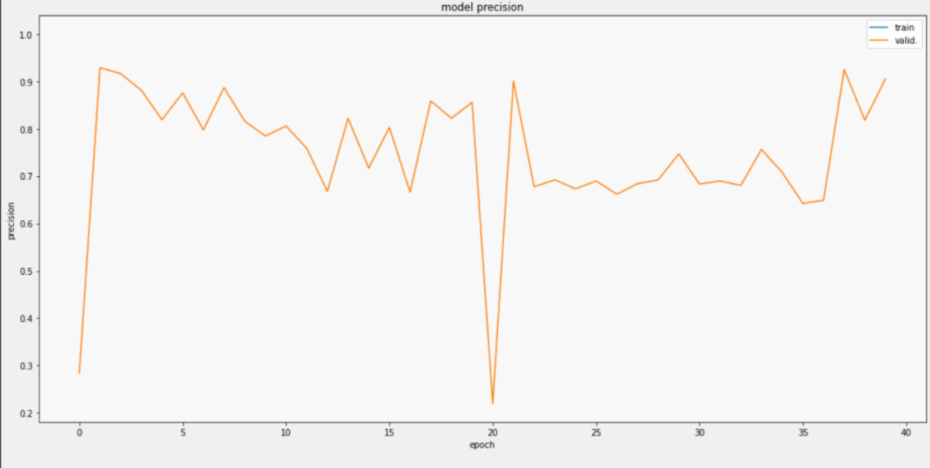
Learning curves
Model recall
ResNext Results
Model precision

Slide 10
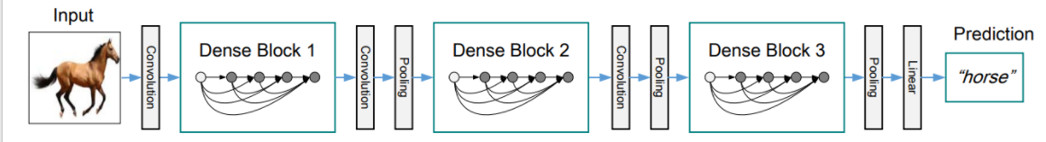
Dense net 161
a popular CNN-based ImageNet used for a variety of applications.
DenseNets exploit the potential of the network through feature reuse (feed-forward connection). Has L(L+1)/2 direct connections.
Adventages: vanishing-gradient problem, encourage feature propagation and feature reuse and reduces the number of parameters.
Best results:

Slide 11
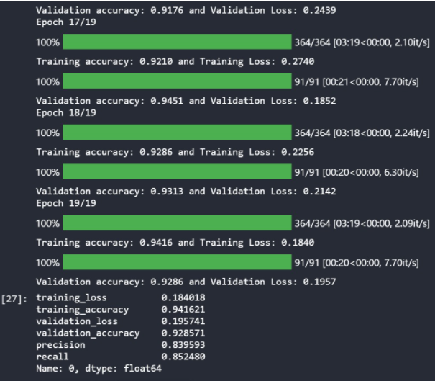
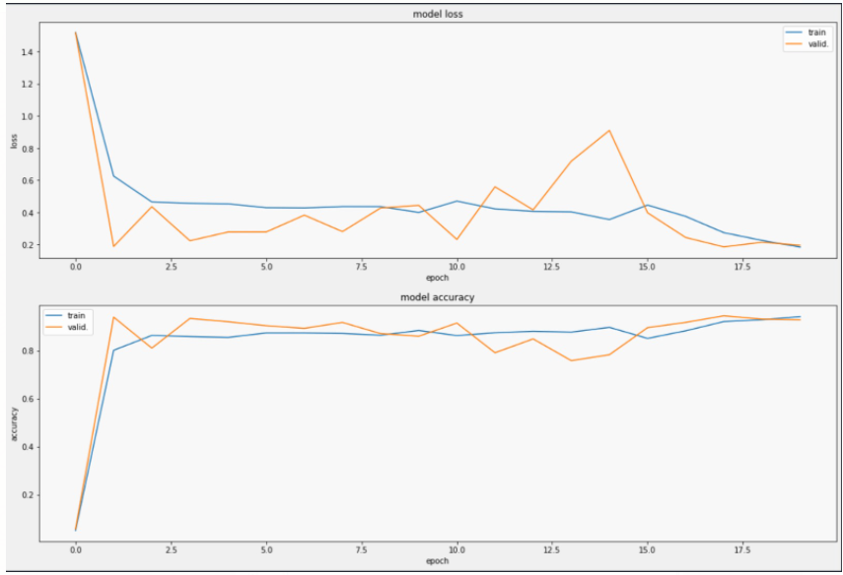
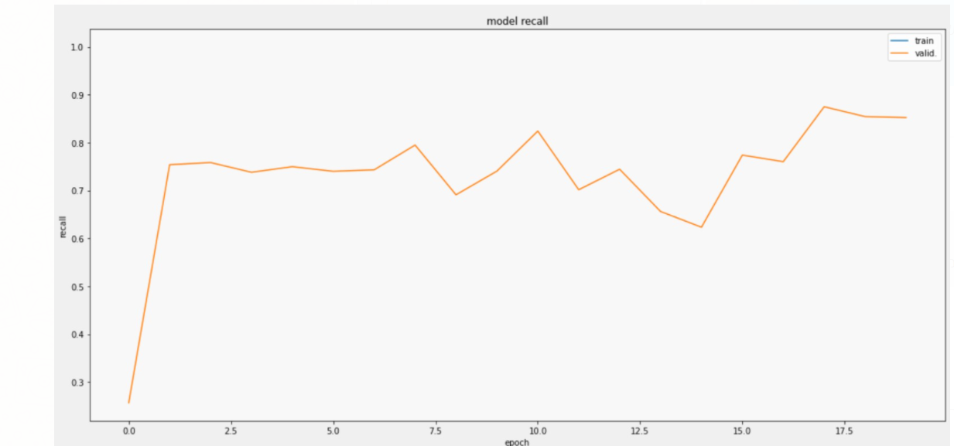
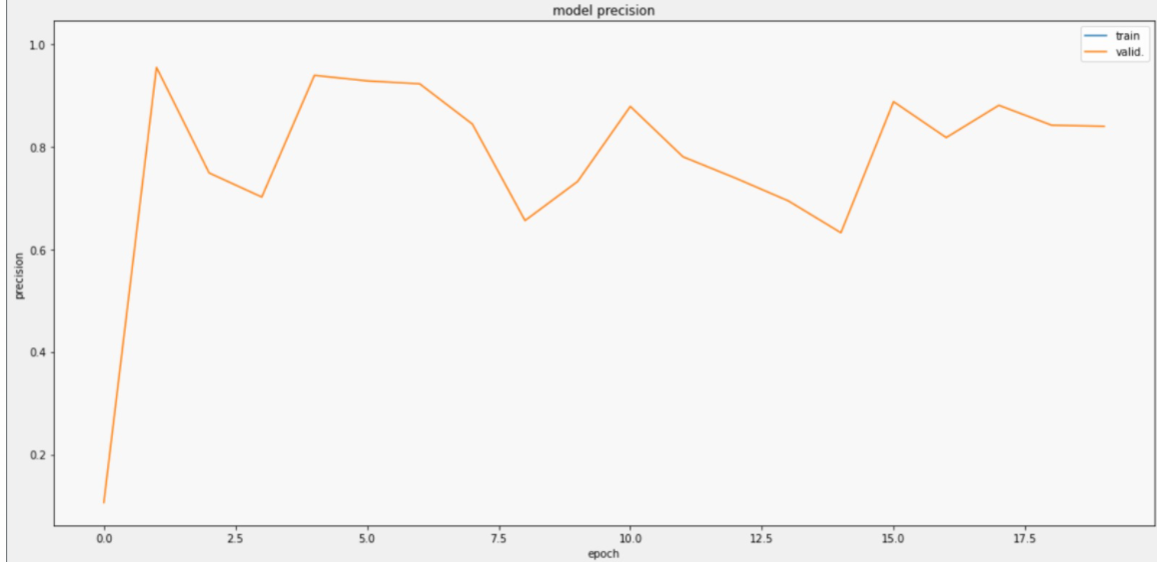
Dense Net
161
Results

Slide 12
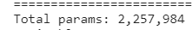
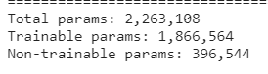
01
MobileNet V2
02
a CNN architecture that seeks to perform well on mobile devices.
It is based on an inverted residual structure (residual connections are between the bottleneck layers).
The intermediate expansion layer uses lightweight depthwise convolutions (non-linearity).
Initial fully convolution layer with 32 filters,and 19 residual bottleneck layers.
Splitting the data with train_test_split of keras – 30-70%, with shuffle
Augmentations (tf) - random_flip_left_right, random_flip_up_down, resize to 160x160
BATCH_SIZE = 32, LR = 0.0001, loss=BinaryCrossentropy, sigmoid activation
5-10 epochs (time and memory limit)
Imagenet weights, defined with tensorflow

Slide 13
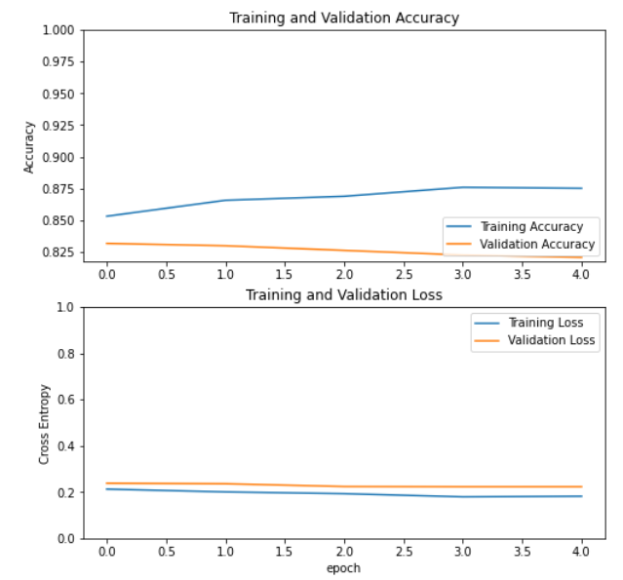
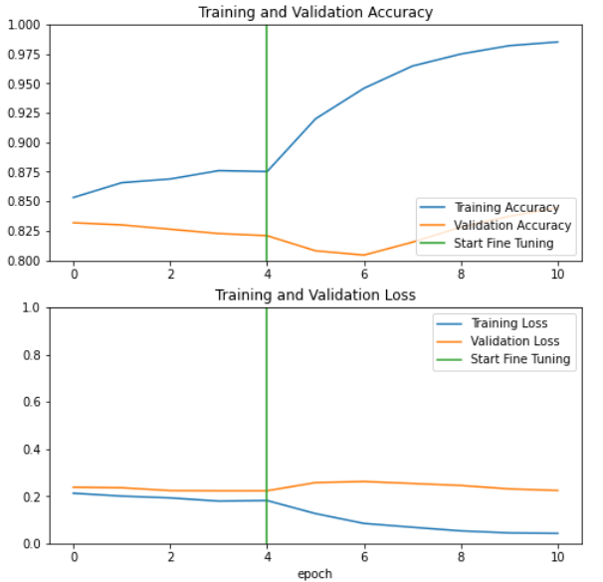
Before
MobileNet V2 - Fine tuning
Best results Before fine tuning:
loss: 0.1816
accuracy: 0.8752
val_loss: 0.2231
val_accuracy: 0.8208
After
Best results after fine tuning:
loss: 0.0424
accuracy: 0.9851
val_loss: 0.2242
val_accuracy: 0.8446

Slide 14
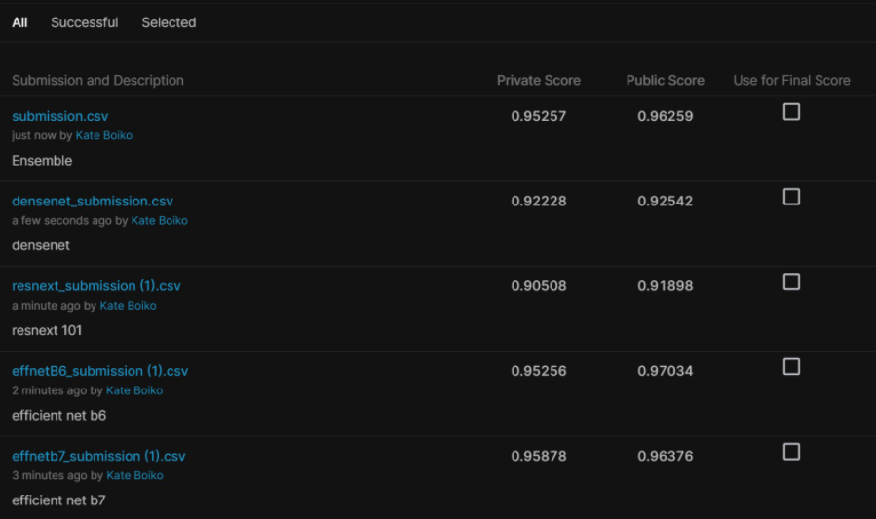
Final Results

Slide 15
Challenges
Long runtime
Working with GPU and Big Data
Installations and dependencies
Limited resources and limited ability to compare between different models
Parallelized & distanced work

Slide 16
Credits
Notebooks we used:
https://www.kaggle.com/bineeshsps/plant-pathology-mobilenet-fine-tunning
https://www.kaggle.com/apthagowda/plant-pathology-2020-pytorch-gpu
https://www.kaggle.com/ibraheemmoosa/plant-pathology-2020-fgvc7-fastai-r18 (heatmap , didn’t use it finally)
Notebooks we used during the course

Slide 17
Thank you!
]]

